Slide 1

GROUP MEMBERS
Shahrin Ahmed
011 123 067
Farzana Gisan
011 131 167
Baymax is on a trip
Computer Graphics

Slide 2
Our Project
Our Project is 2D cartoon . The theme is
The cartoon character ‘Baymax’ is on a trip at the riverside . The weather is very nice with blue sky and bright sun. There are sailing boats far beyond the horizon.
‘Baymax’ is activated from his ‘charging bay’ and moves where he wants to go.
Children loves ‘Baymax’ . When Baymax goes near the ‘little girl’,the girl gives her ‘balloon’ to ‘Baymax’ as a gift.
When ‘Baymax’ needs to be charged he returns to his ‘charging bay’.

Slide 3
Individual Tasks
By Shahrin Ahmed :
Background scenery
Cloud
Land
Tree
Bush
grass
Rock
Object
Balloon
Chair/Charging bay

Slide 4
Individual Tasks
Character
Baymax.
Little girl.
By Shahrin Ahmed :

Slide 5
Individual Tasks
By Farzana Gisan:
Background scenery
sky
River
Sun
Hill
Object
Ball
Boat.

Slide 6
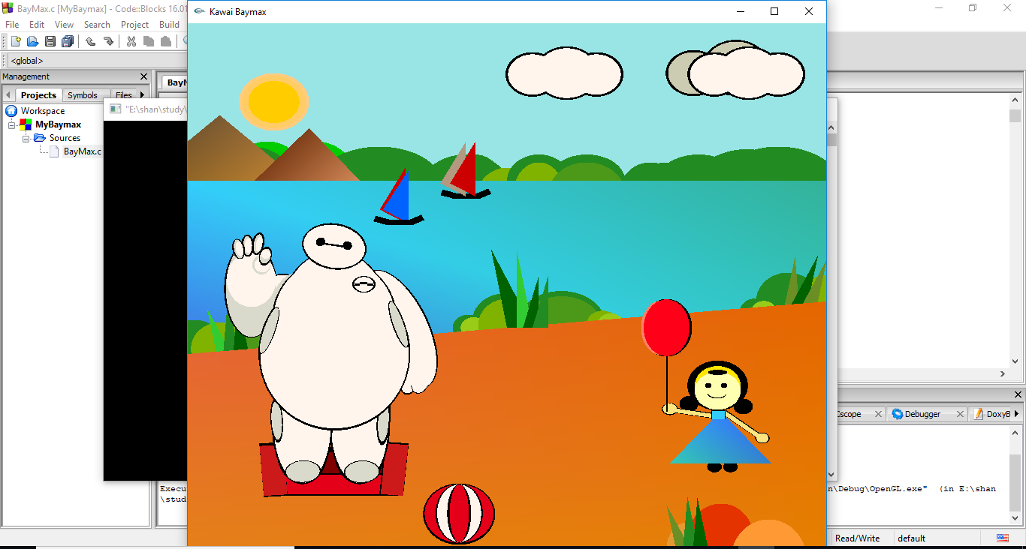
ScreenShots of our project

Slide 7
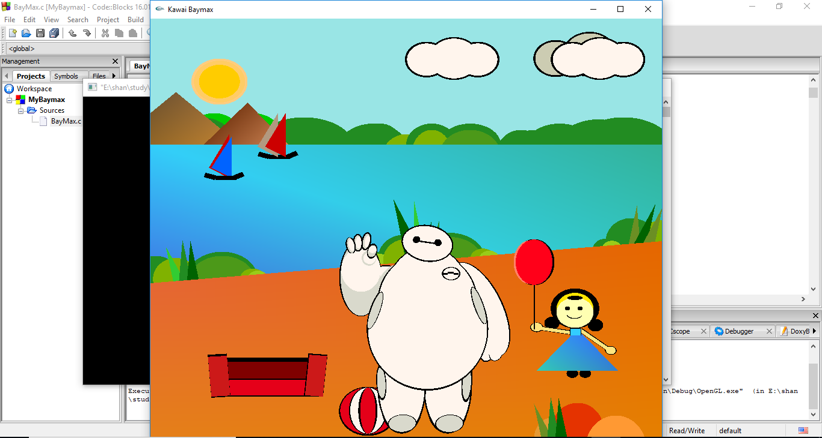
travbuddy.com- Home

Slide 8
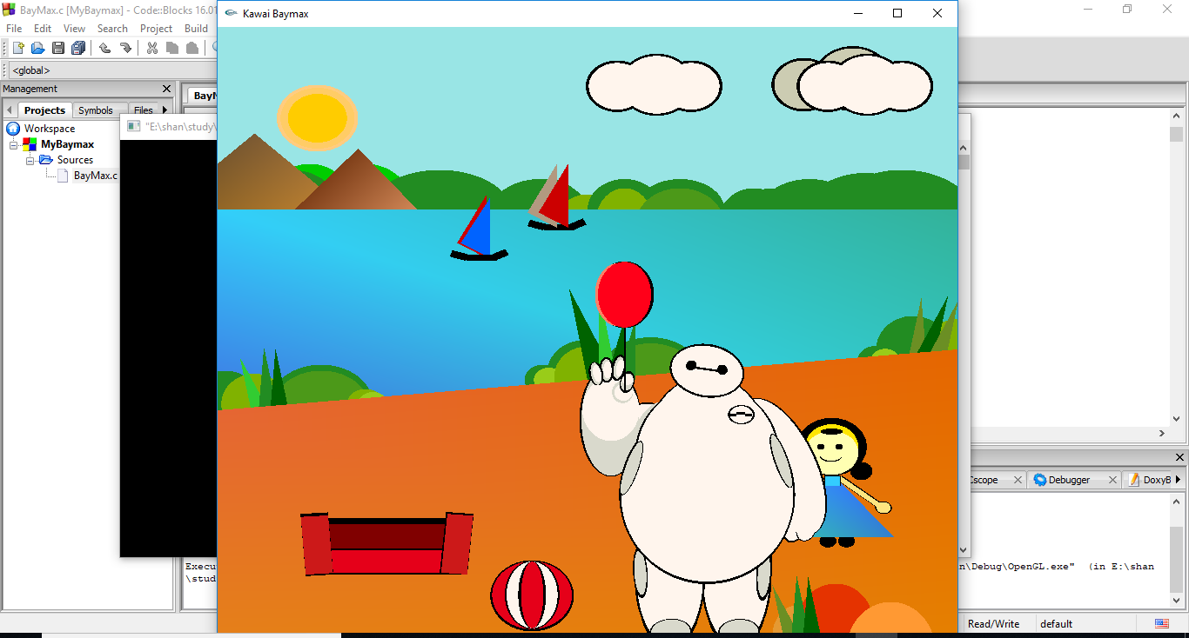

Slide 9


Slide 10
THANK YOU
THANK YOU FOR YOUR
TIME & PATIENCE

